Slide 1
Fundamentals of Geographic Information: scale, projections, coordinate systems

Slide 3
Map scale - ratio (or proportion) between measurements on the map and corresponding measurements on the ground.

Slide 4
“What do you consider the largest map that would be really useful?”
“About six inches to the mile.”
“Only six inches!” exclaimed Mein Herr. “We very soon got to six yards to the mile. Then we tried a hundred yards to the mile. And then came the grandest idea of all! We actually made a map of the country on the scale of a mile to a mile!”
“Have you used it much?” I enquired.
“It has never been spread out, yet,” said Mein Herr: “the farmers objected: they said it would cover the whole country and shut out the sunlight! So we now use the country itself, as its own map, and I assure you it does nearly as well.”
From Lewis Carol. Sylvie and Bruno Concluded. London: Macmillan, 1893. P. 169.

Slide 5
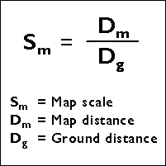
How does one calculate map scale?
Dm and Dg are in the same units of measurement

Slide 6
Imagine that you are a jogger, and you want to determine how far you ran in today’s workout. You measure the jogging path on a map. The path is 150 millimeters long on the map. The scale of the map is 1:24,000. What is the length of the real jogging path?
3.6km
Notes:
Map scale = 1 / 24,000 = 150 mm / Ground distance
Ground distance = 24,000 × 150 mm
Ground distance = 3,600,000 mm
In other words, you jogged 3.6 kilometers (1 million mm in a km)
Equivalent fraction
1/24000 == 150/?

Slide 7
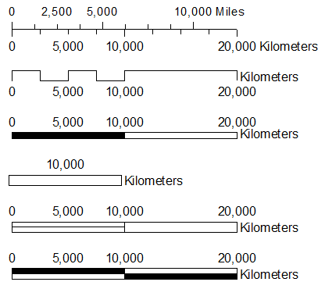
3 Methods for Expressing Map Scale
REPRESENTATIVE FRACTION: ratio or fraction
1:100,000 or 1/1,000,000
VERBAL STATEMENT
“one inch to sixteen miles”
GRAPHIC BAR
© 2013 Brian Tomaszewski

Slide 8
Large & Small Scale
Small scale = 1:30,000,000
example – world map on 8.5 X 11 page
Large scale = 1:24,000 (or larger)
USGS Topographical Map Series
Use the value of Sm to determine small v. large scale

Slide 9
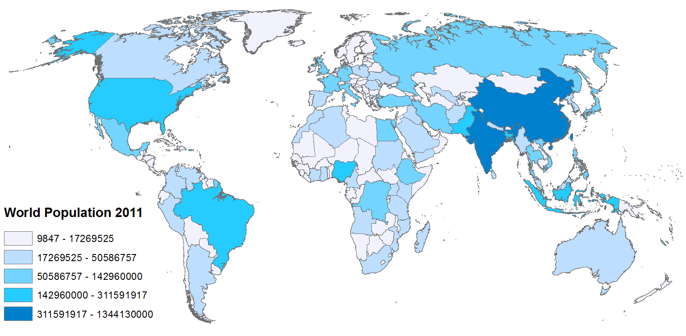
LARGE OR SMALL SCALE?
© 2013 Brian Tomaszewski

Slide 10
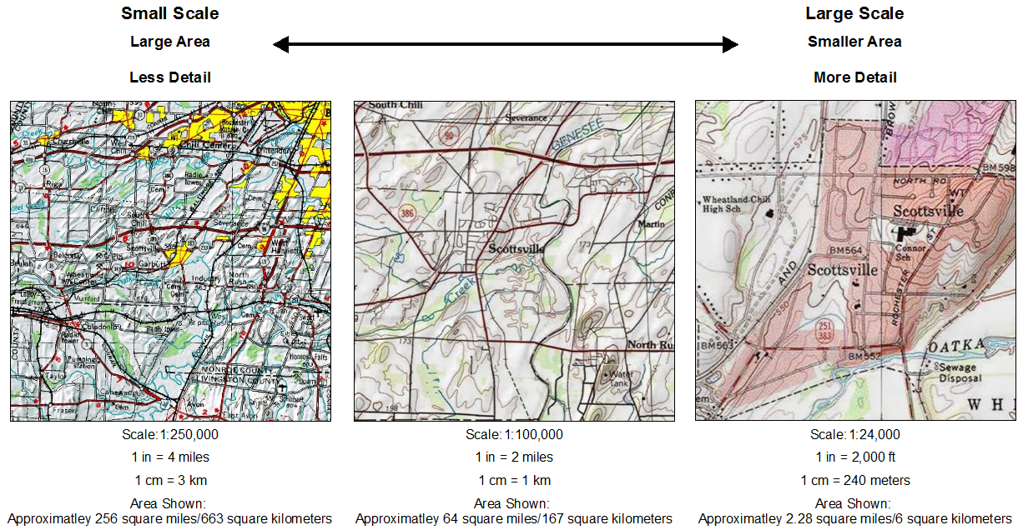
What is map scale?
© 2013 Brian Tomaszewski

Slide 11
Why do we care about scale?
Data detail is scale-dependent
Accuracy is scale-dependent
USGS National Map Accuracy Standards
Horizontal Positional Accuracy: 90 percent of well-defined points tested are within 0.02 inches of true position.
Real world values vary depending on map scale
Vertical Positional Accuracy: 90 percent of well-defined points tested are within one-half contour interval of the correct value.

Slide 12
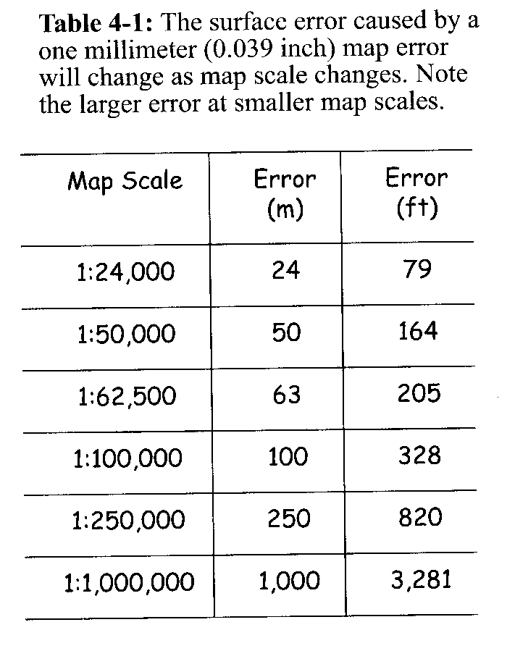
Detail, Accuracy and Scale
Oatka Creek Example
GIS Fundamentals, Paul Bolstad, 2002

Slide 13
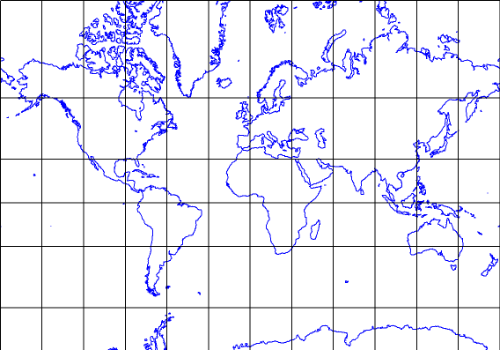
Scale is not constant across a map
0º
40,000 km

Slide 14
Scale is not constant across a map
0º
1: 200,000,000

Slide 15
Scale is not constant across a map
60º
20,088 km
0º
1:200,000,000

Slide 16
Scale is not constant across a map
60º
1:100,440,000
0º
1:200,000,000

Slide 17
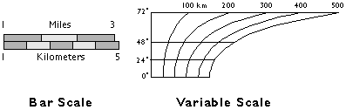
Scale not constant across a map
This issue is more pronounced on smaller scale maps (e.g., global).
Large scale maps
Small scale maps

Slide 18

Map Projections

Slide 19
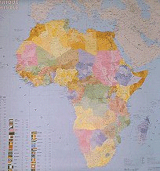
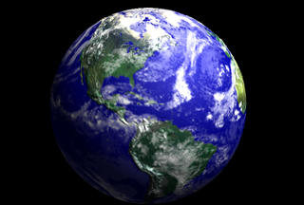
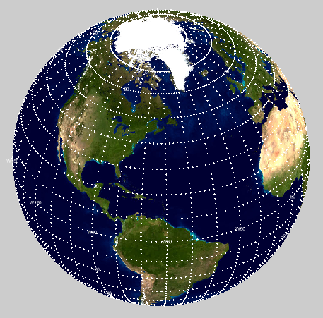
What is a Map Projection?
A method of representing the earth's three-dimensional surface as a flat two-dimensional surface.
Mathematically convert geographic
(latitude and longitude) coordinates into planar Cartesian (x,y) coordinates

Slide 20
What you need to know -
Projections are mathematical transformations
Scale is true only in certain places
Many different types have been devised
All map projections distort
Distortion characteristics vary from type to type
Some types are better for some applications than others
A few types are used widely

Slide 21
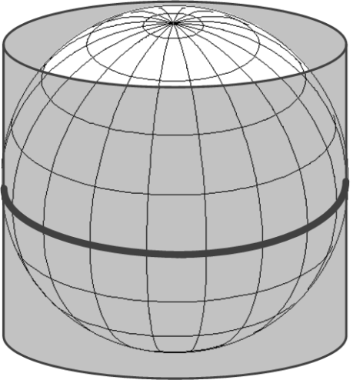
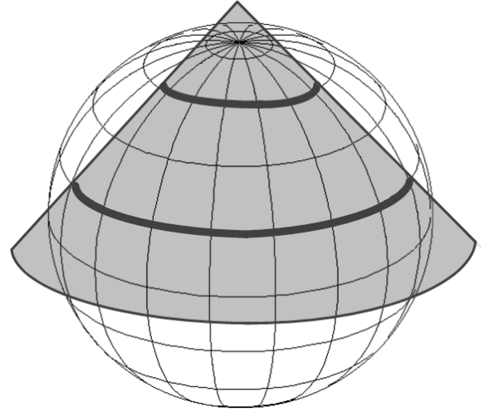
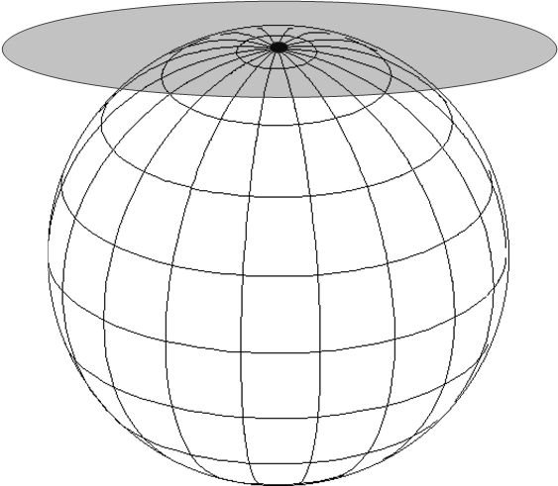
The 3 common projection surfaces
Cylinder
(Cylindrical projection)
Cone
(Conic projection)
Plane
(Planer or Azimuthal projection)
tangent
secant
tangent
tangent – being in contact at a single point or along a line
secant – cutting, intersecting
Images © 2013 Brian Tomaszewski

Slide 22
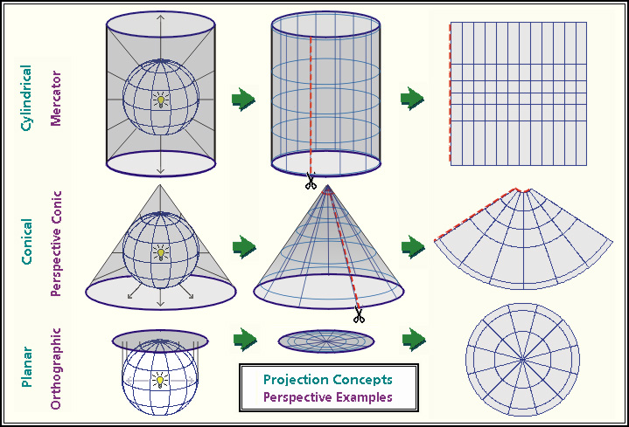
Three Basic Types
Source: http://www.geog.ucsb.edu/~dylan/mtpe/geosphere/topics/map/map1.html

Slide 23
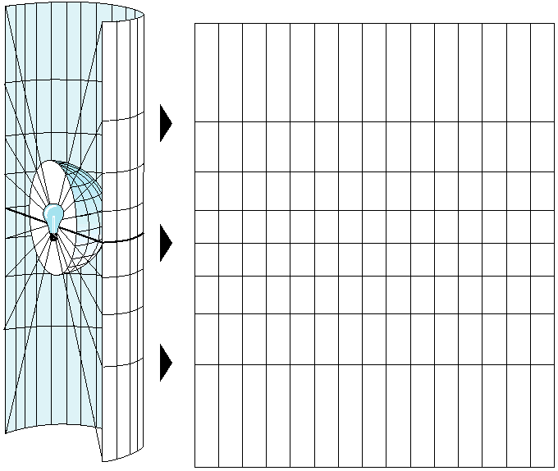
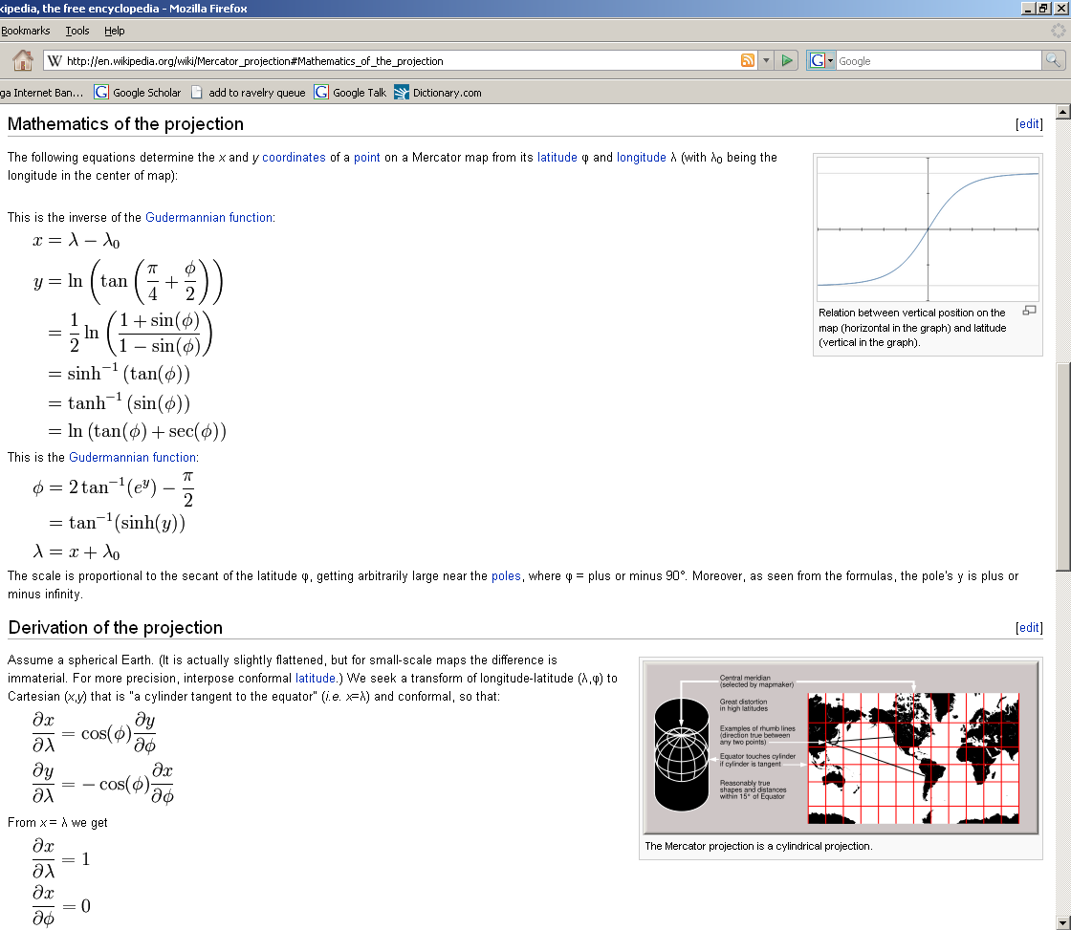
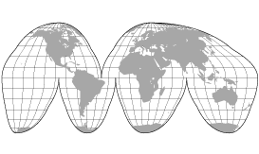
Projections are mathematical transformations
Points, lines, etc., on the curved surface of Earth are rendered onto a flat map surface.
The light bulb analogy is fine,
except for certain special projections.

Slide 24
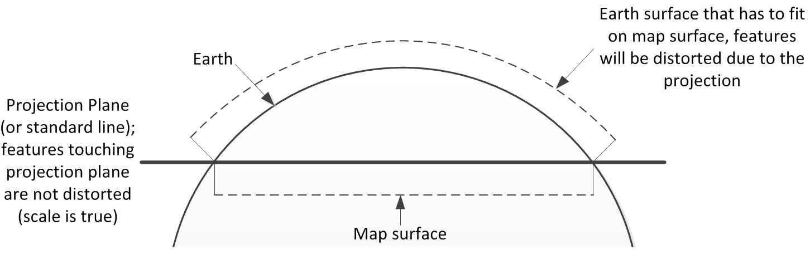
Cylinder
(Cylindrical projection)
Cone
(Conic projection)
Plane
(Planer or Azimuthal projection)
tangent
secant
tangent
Scale is increasingly distorted with increasing distance away from the lines or point of tangency.
Images © 2013 Brian Tomaszewski
Notes:
http://help.arcgis.com/en/arcgisdesktop/10.0/help/00v2/GUID-3C127751-9E45-4B57-8EB4-C5F38A3A3E15-web.png
http://help.arcgis.com/en/arcgisdesktop/10.0/help/00v2/GUID-CEE860DC-036F-4DCC-8C98-9A639CE62EDB-web.png

Slide 25
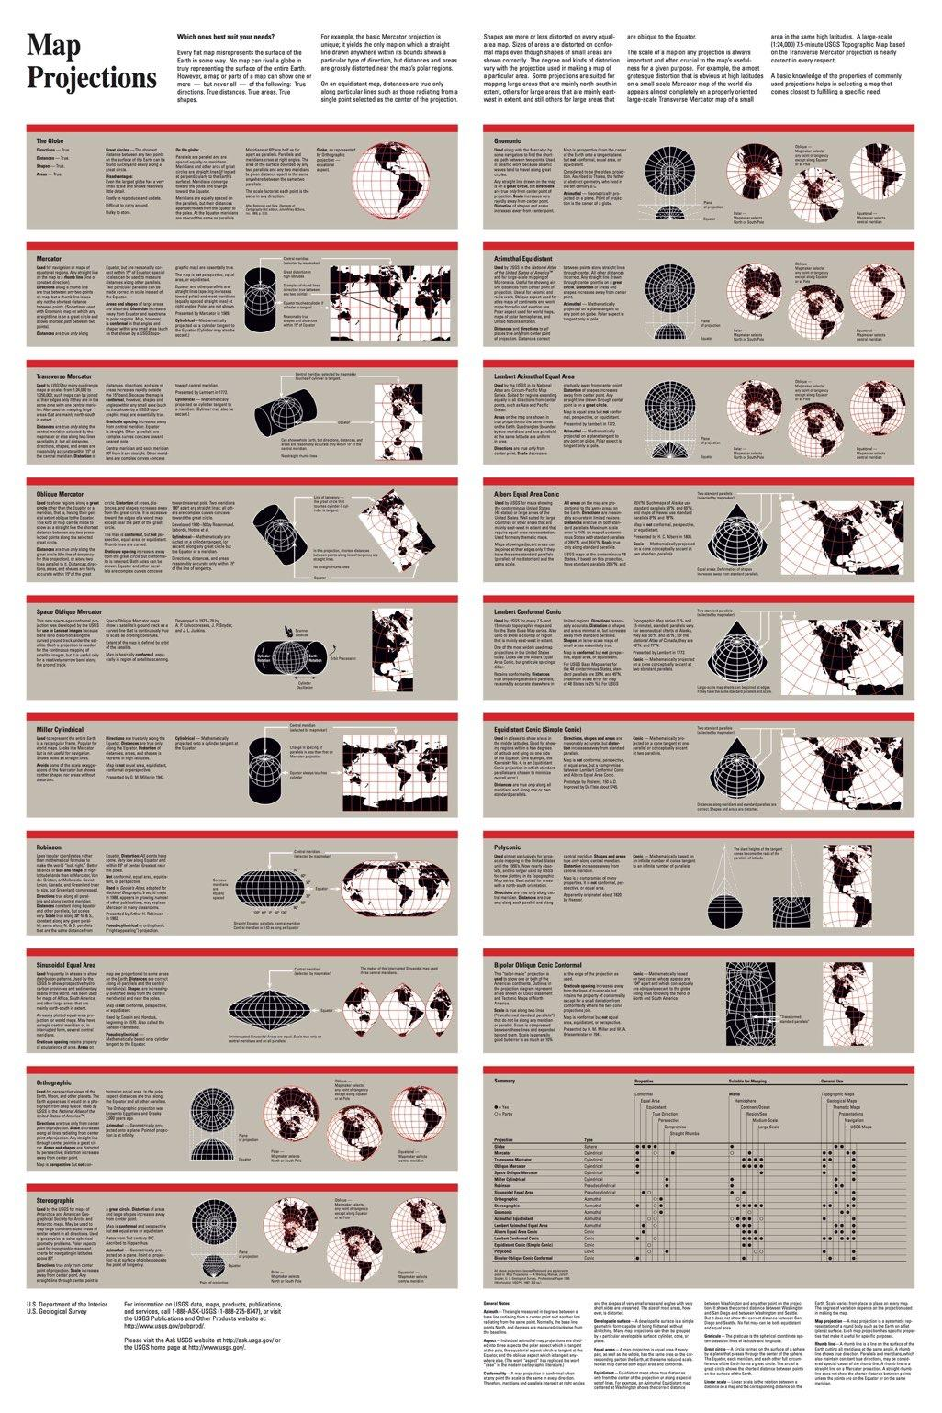
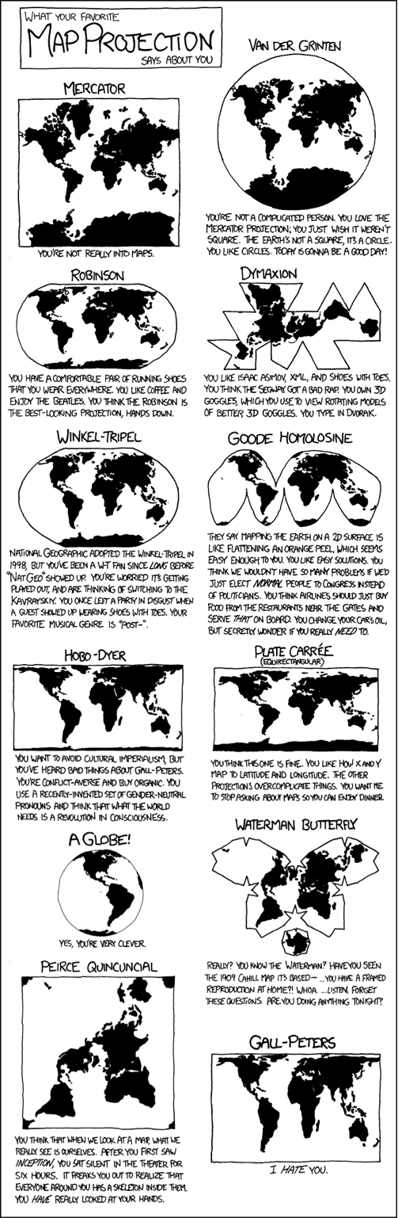

Slide 26
Properties of Map Projections
The process of flattening the earth will cause distortions in one or more of the following spatial properties:
Distance
Area
Shape (or angles)
Direction
When a flat map is made, choices are made, depending on the intended use of the map, as to which of these properties to preserve.
No projection can preserve all these properties; as a result, all flat maps are distorted to some degree.

Slide 27
Four Classes based on distortion
Conformal – preserves shape and angles
Equal Area (Equivalent) – preserves area and size
Equidistant – preserves distances in some directions
Azimuthal – preserves angles from a specific point
Notes:
Conformal – preserves shape and angles
Equal Area (Equivalent) – preserves area and size
Equidistant – preserves distances in some directions
Azimuthal – preserves angles from a specific point

Slide 28
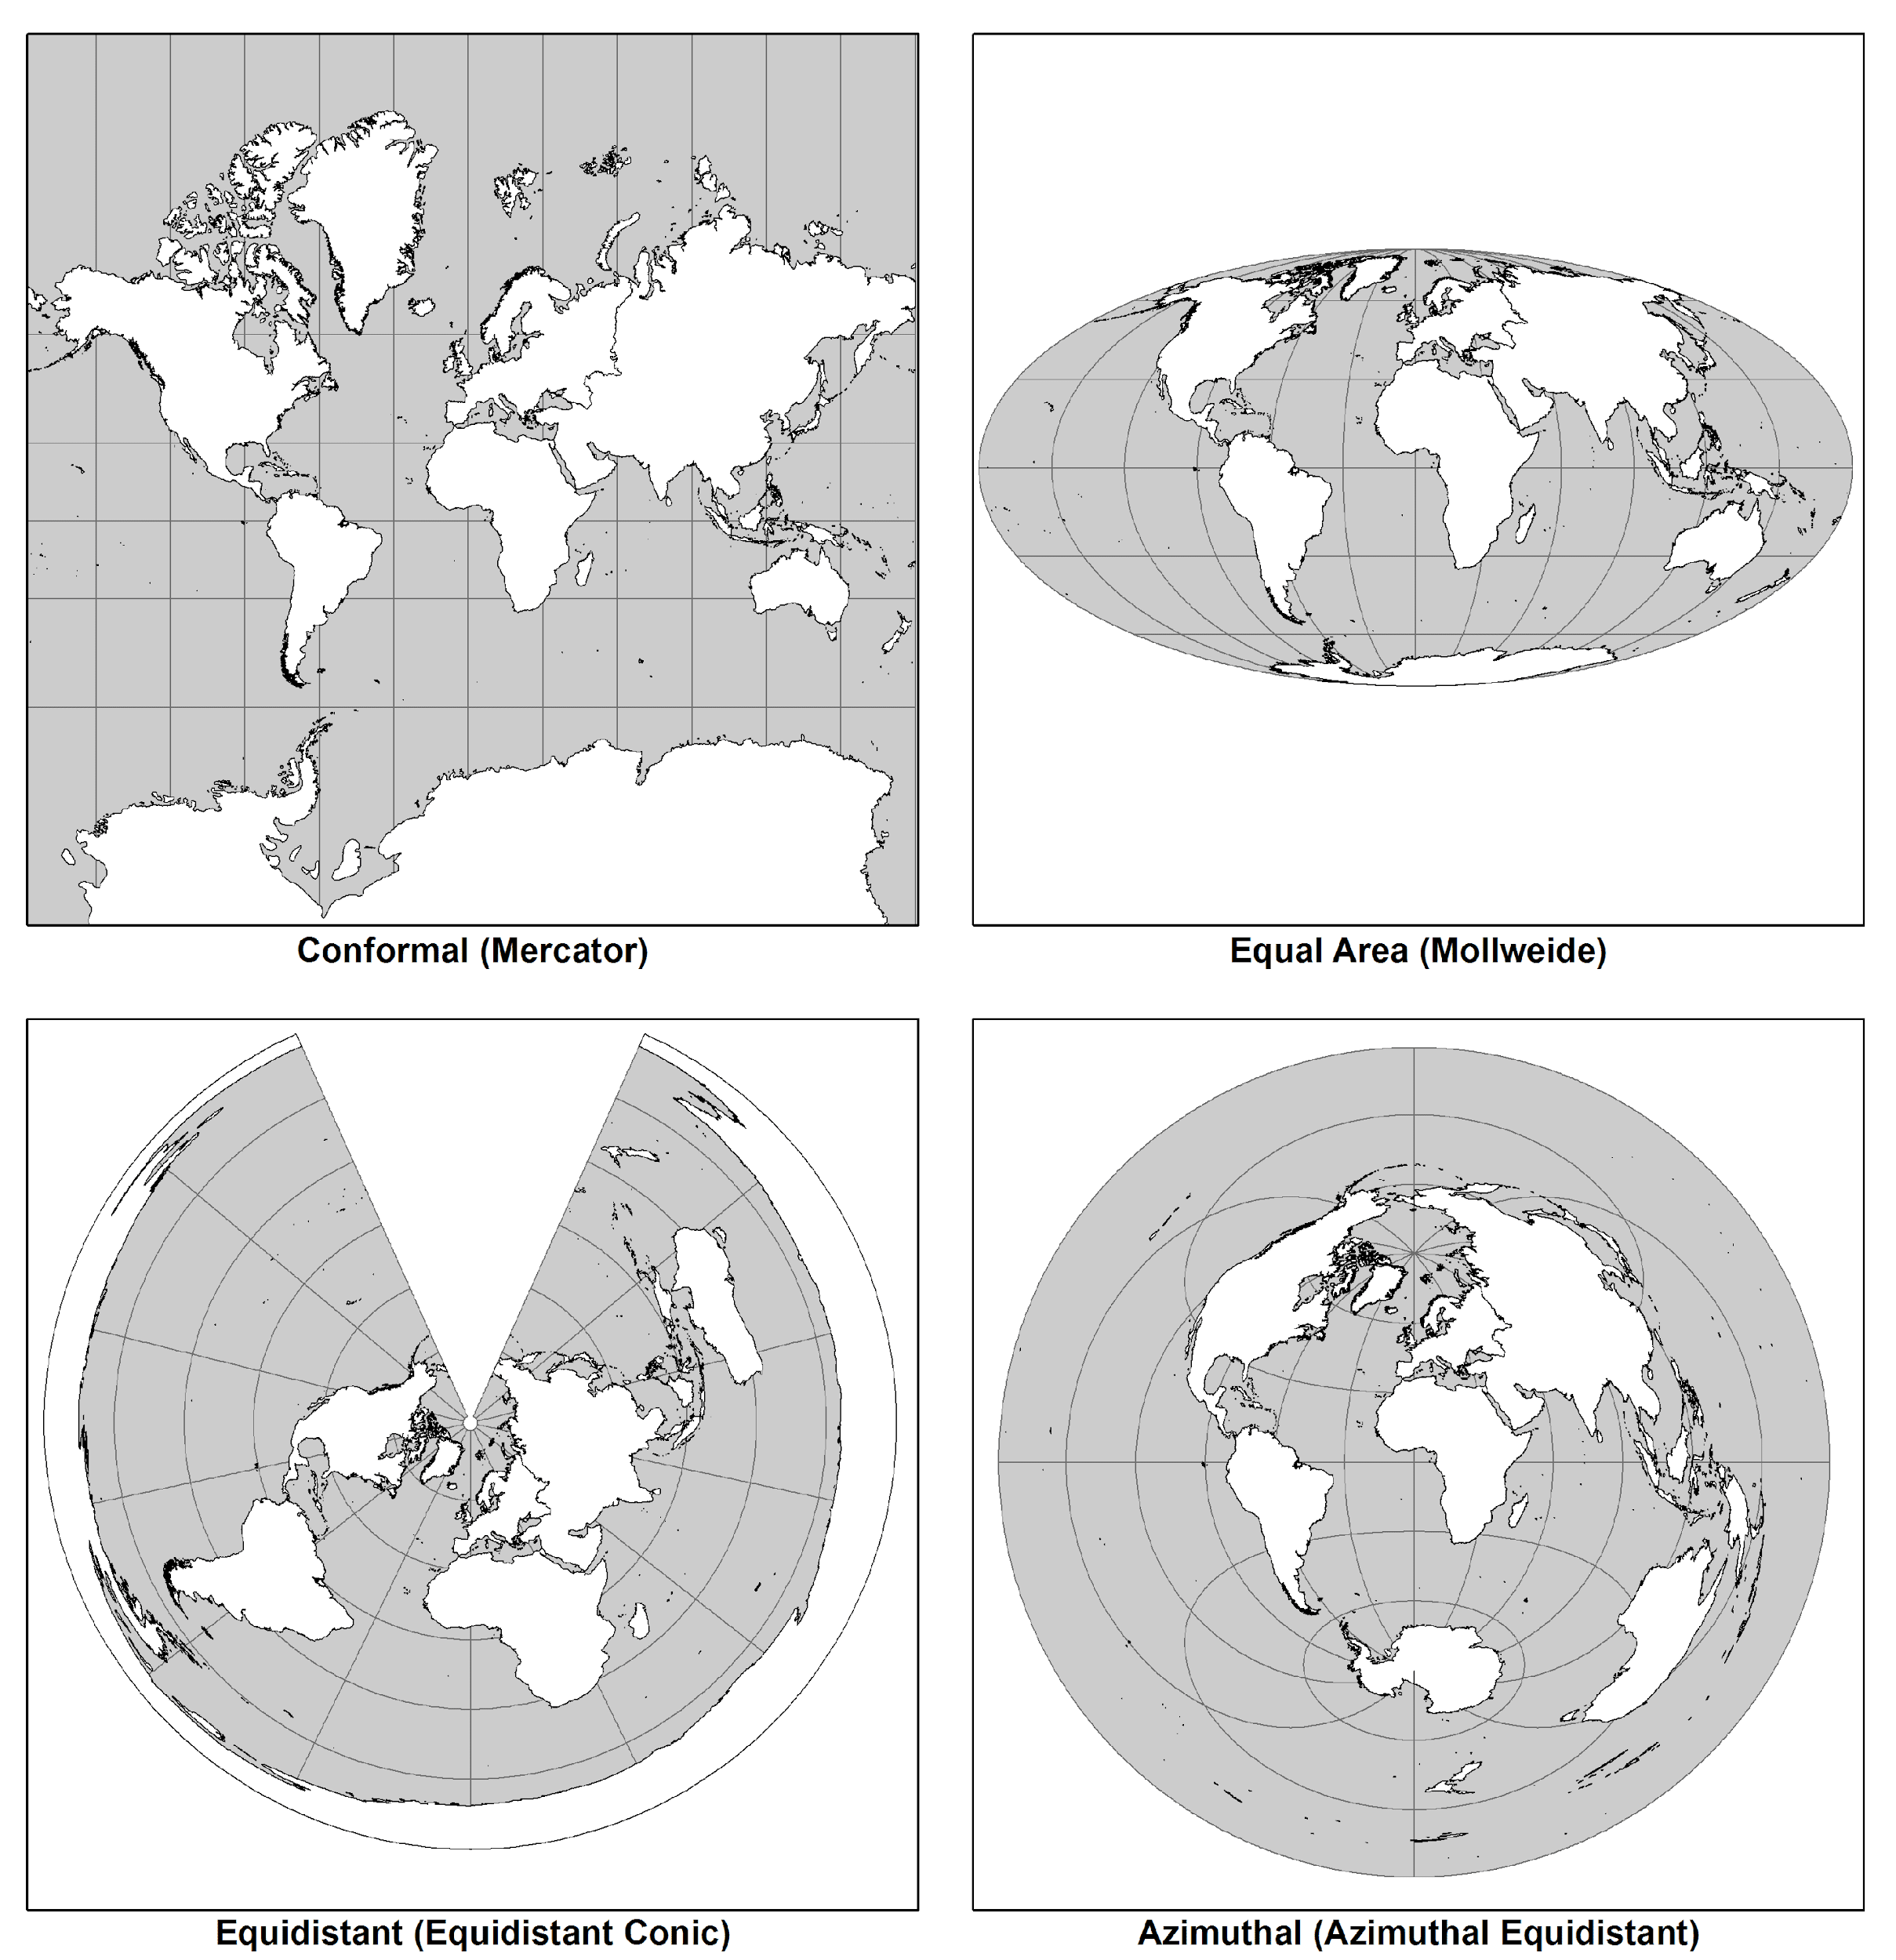
© 2013 Brian Tomaszewski

Slide 29
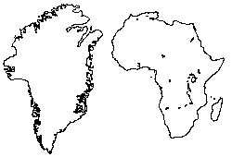
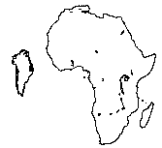
Conformal v. Equal-Area
Conformal –
Shapes are maintained
Sizes are incorrect
Mercator
Greenland v. Africa
Equal-Area –
Shapes are distorted
Sizes are correct
Mollweide
http://www.progonos.com/furuti/MapProj/Normal/CartProp/AreaPres/areaPres.html

Slide 30
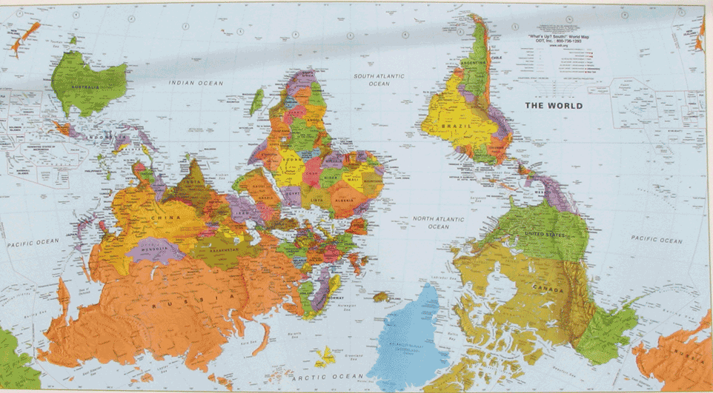
When up becomes down..
http://www.wall-maps.com/World/UpsideDownWorldMap.htm
Van der Grinten projection - "compromise" projection.

Slide 31
Which projections are most widely used?
True angle (conformal) projections for large scale maps and coordinate systems (UTM, SPCs)
True area (equal area) and compromise projections for small scale maps of the U.S. and world
True distance (equidistant) and true direction (azimuthal) projections for special projects.

Slide 32
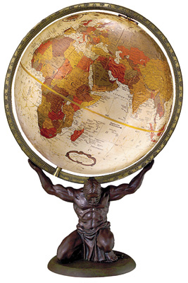
What is the only representation of the Earth that does not distort anything?
A Globe

Slide 33
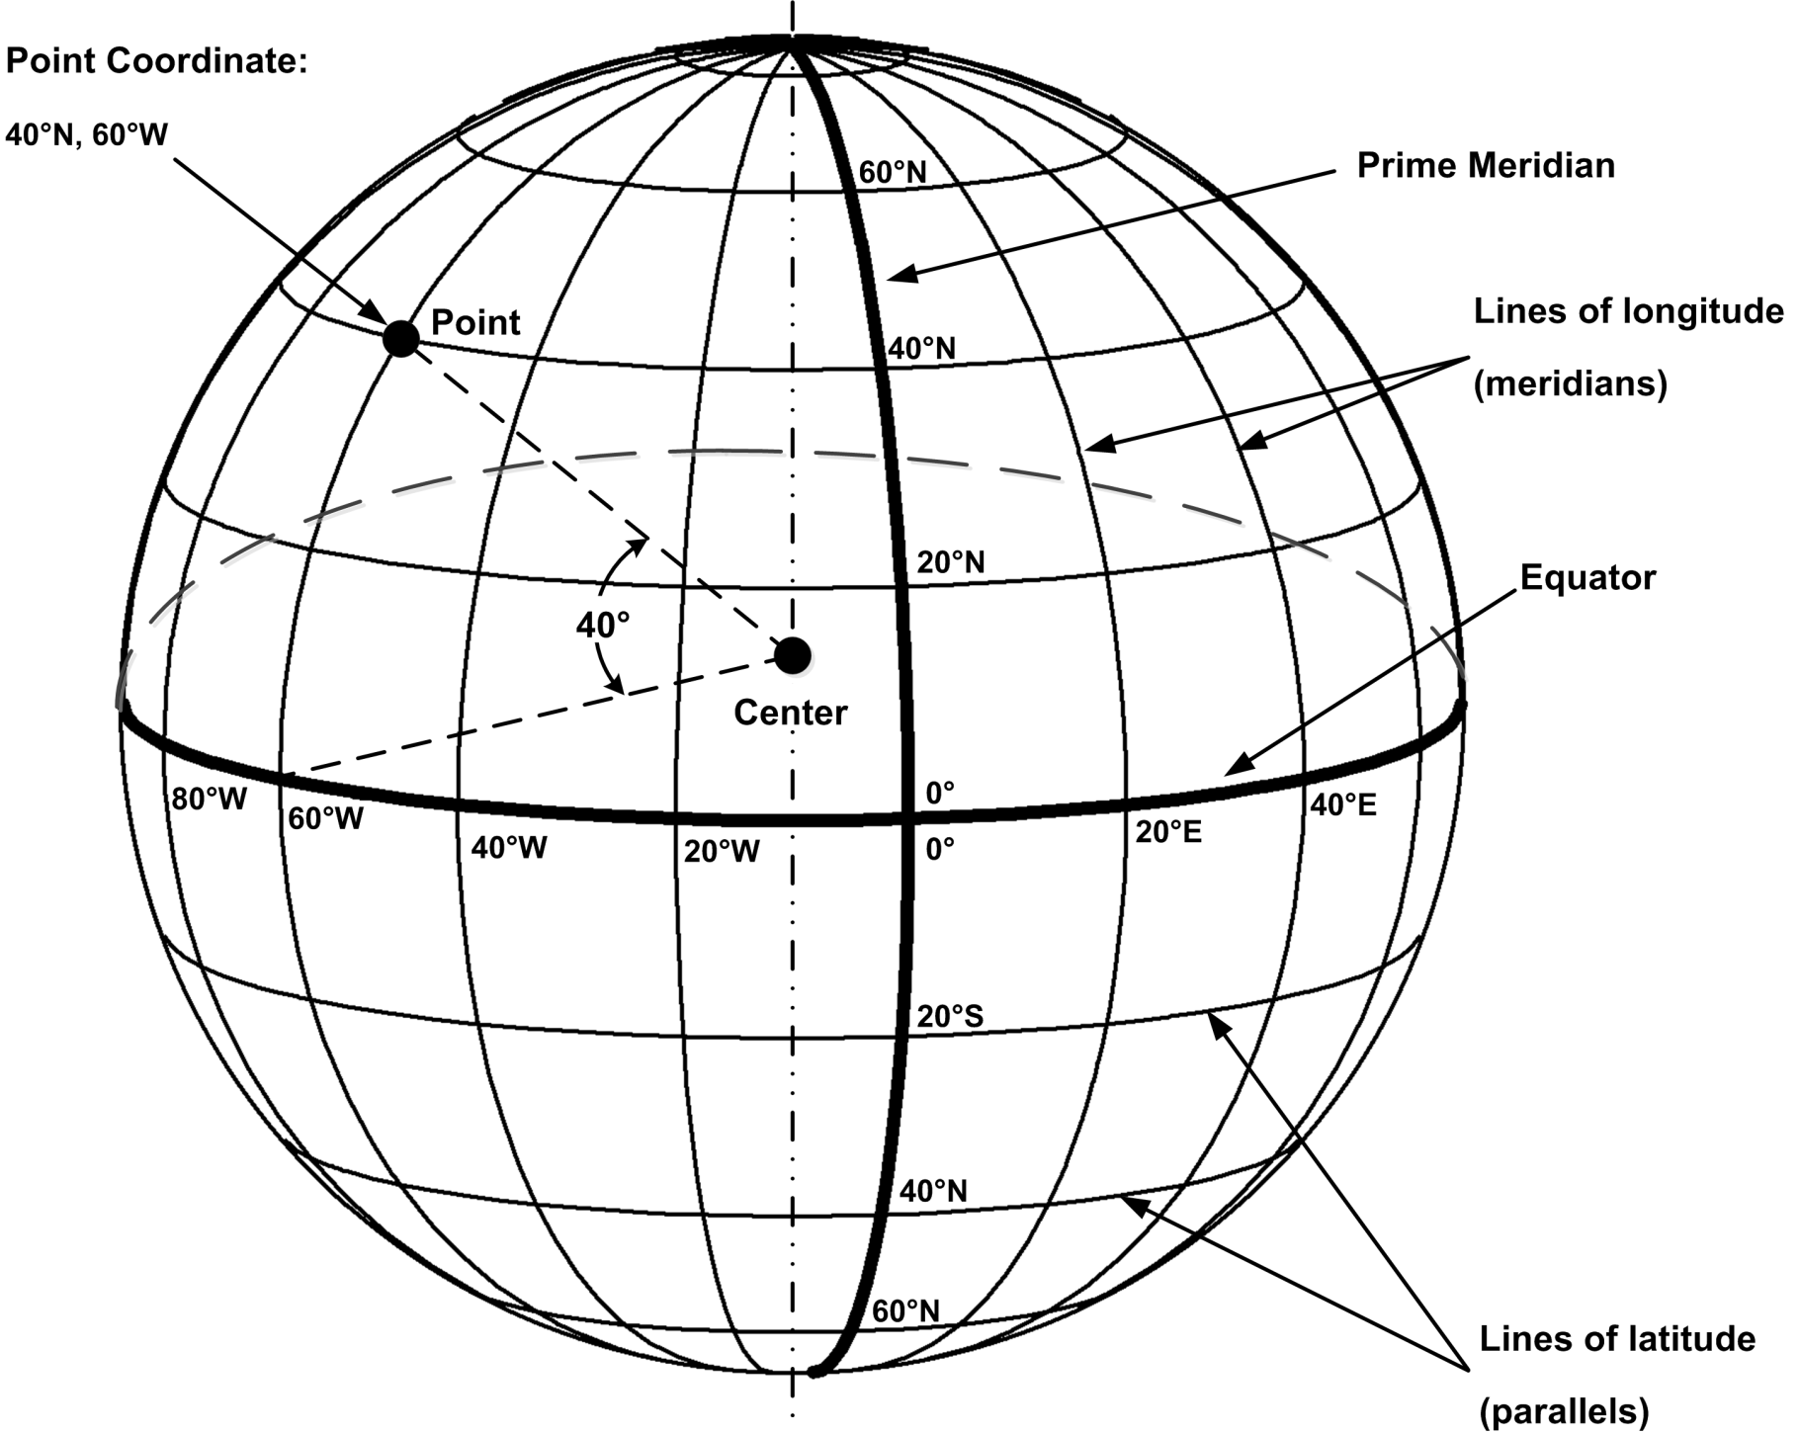
Coordinate Systems
© 2013 Brian Tomaszewski

Slide 34
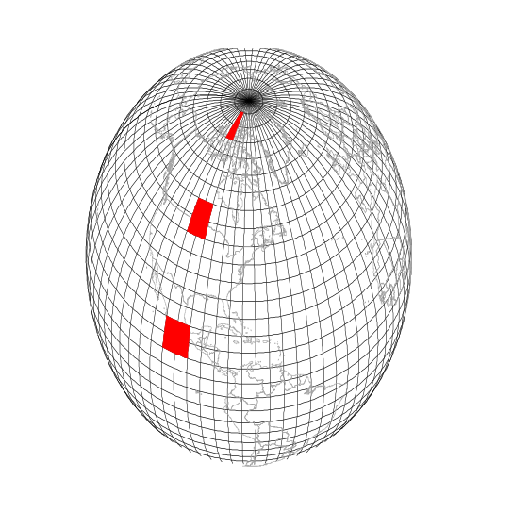

Why plane coordinates?
Surveyors are concerned with accurate measurements.
Plane coordinates are based on projections which inherently contain error – So why use them?
It’s more efficient and meaningful to measure using planar coordinates than it is with spherical coordinates
Feet and Meters
v.
Degrees, minutes, seconds

Slide 35
Two plane coordinate systems
Universal Transverse Mercator (UTM) system
State Plane Coordinate (SPC) system

Slide 36
The Universal Transverse Mercator (UTM) Projection
A type of cylindrical projection
Implemented as an internationally standard coordinate system
Initially devised as a military standard
Uses a system of 60 zones
Maximum distortion is 0.04%
Transverse Mercator because the cylinder is wrapped around the Poles, not the Equator
© 2005 John Wiley & Sons, Ltd

Slide 37
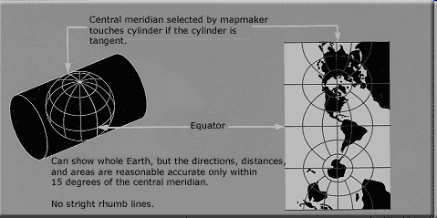
http://upload.wikimedia.org/wikipedia/commons/b/b9/Usgs_map_traverse_mercator.PNG

Slide 38
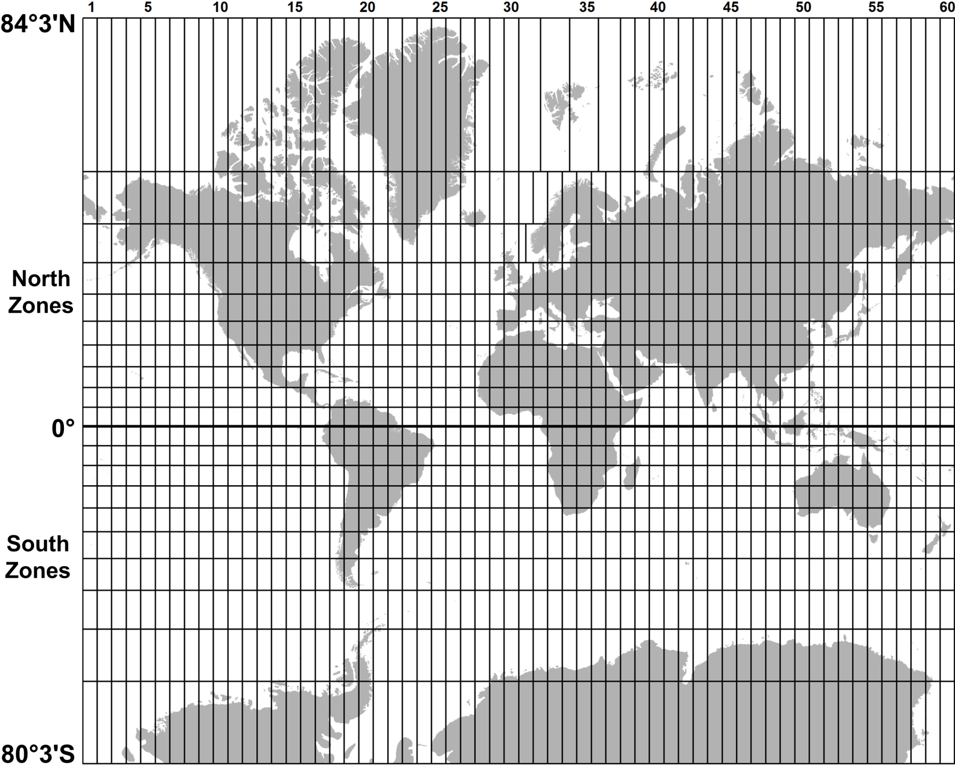
60 UTM zones (north and south)
© 2013 Brian Tomaszewski

Slide 39
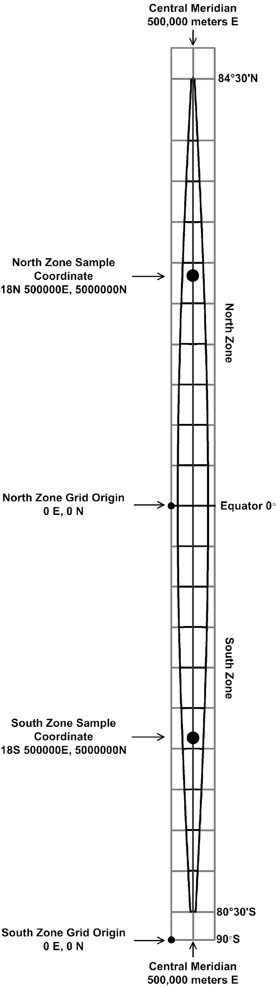
Characteristics of one UTM zone
Equator = 0m N for North Zone
Central meridian zone = easting of 500,000m E
A UTM coordinate = (1) the zone number, (2) the north or south hemisphere (N or S), (3) the six-digit easting (E) value and (4) the seven-digit northing (N) value. Sample Coordinate is: 18N 500000E, 5000000N
A whole zone
detail
© 2013 Brian Tomaszewski

Slide 40
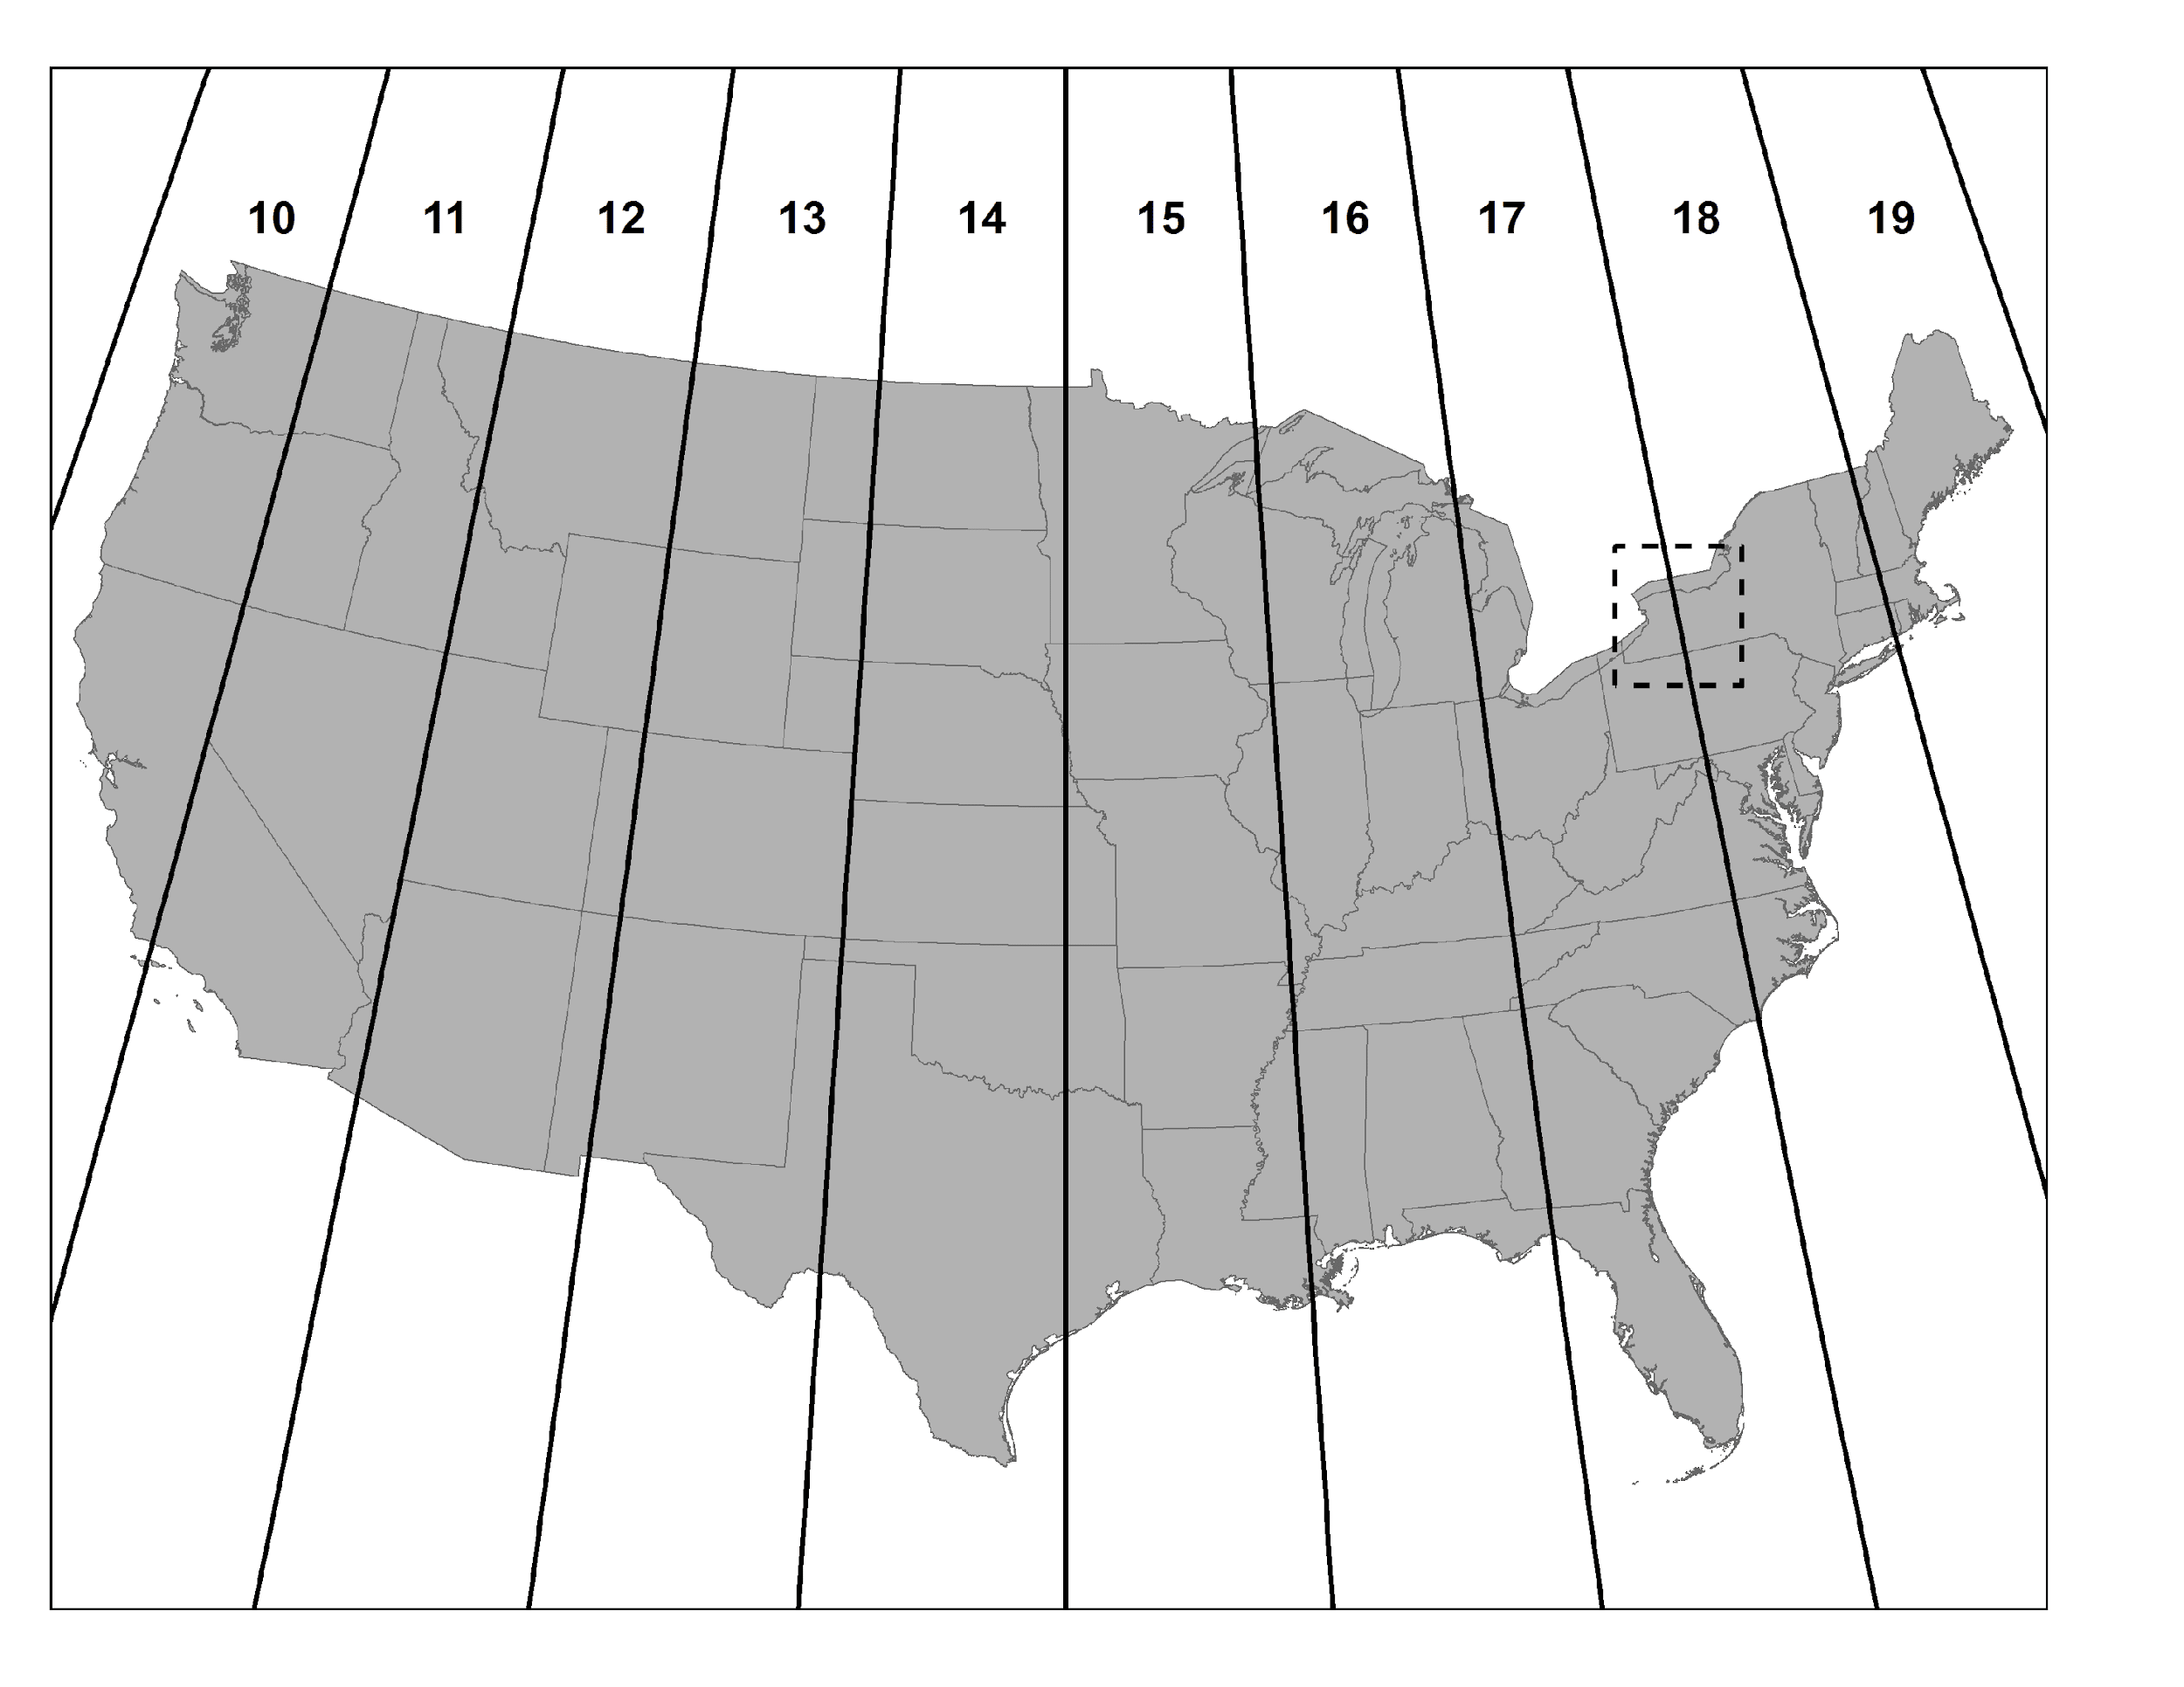
UTM Zones for the United States
© 2013 Brian Tomaszewski
Not perfect – Error. NY is divided….

Slide 41
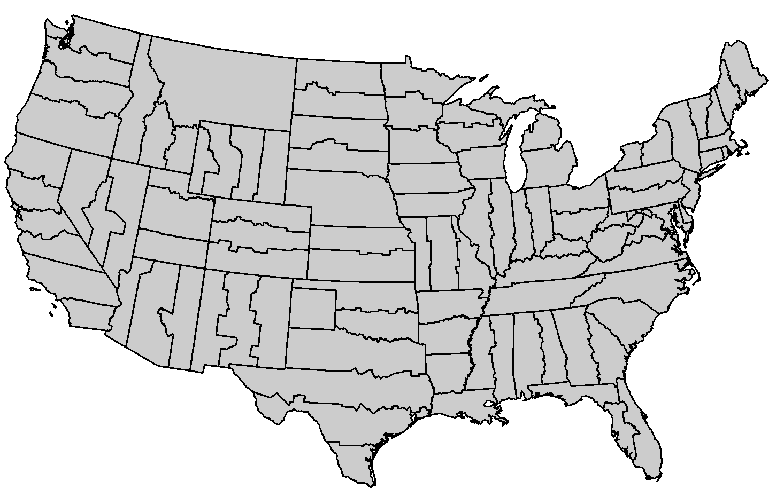
122 SPCs zones
State Plane Coordinate System
© 2013 Brian Tomaszewski

Slide 42
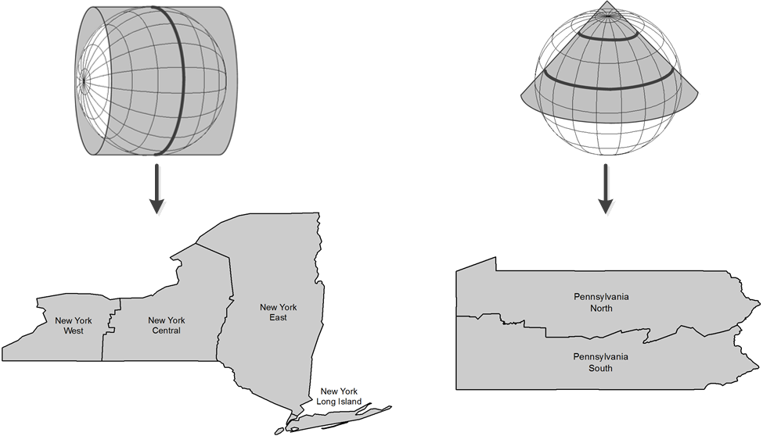
Map projections for SPCs zones
Transverse Mercator
(for
North-South regions)
Lambert Conic Conformal
(for
East-West regions)
Why? Distortion is zero along the central meridian
Why? Distortion is least along the standard parallels
© 2013 Brian Tomaszewski

Slide 43
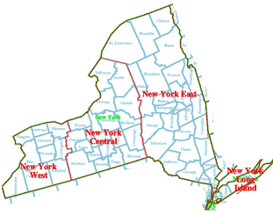
NYS SPC
http://www.vterrain.org/Locations/us/ny/sp_basemap_newyork.png

Slide 44
What is a datum?
A horizontal datum is the combination of :
a reference ellipsoid
2) accurately known control points on the surface of Earth. (In degrees of longitude and latitude – these establish the basis for making measurements of location in the spherical coordinate system.)

Slide 45
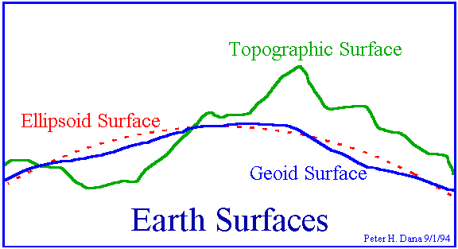
Ellipsoid
“Smooth out” the surface of the Earth.
Topographic Surface: The Earth’s real shape
Geoid Surface: Sea level everywhere on Earth
Ellipsoid: Approximation of the Geoid

Slide 46
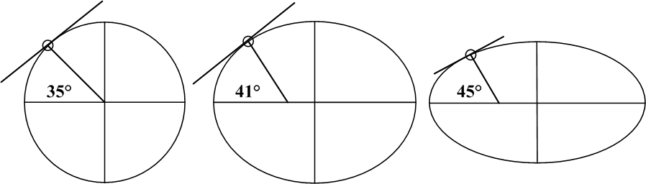
Reference Ellipsoid
Mathematical approximation of the Earth’s shape.
The Earth in not a perfect sphere, it is more of an ellipse (egg-shaped) and must be approximated
Same spot on the surface, but a different ellipsoid… gives you a different Latitude value.
© 2013 Brian Tomaszewski

Slide 47
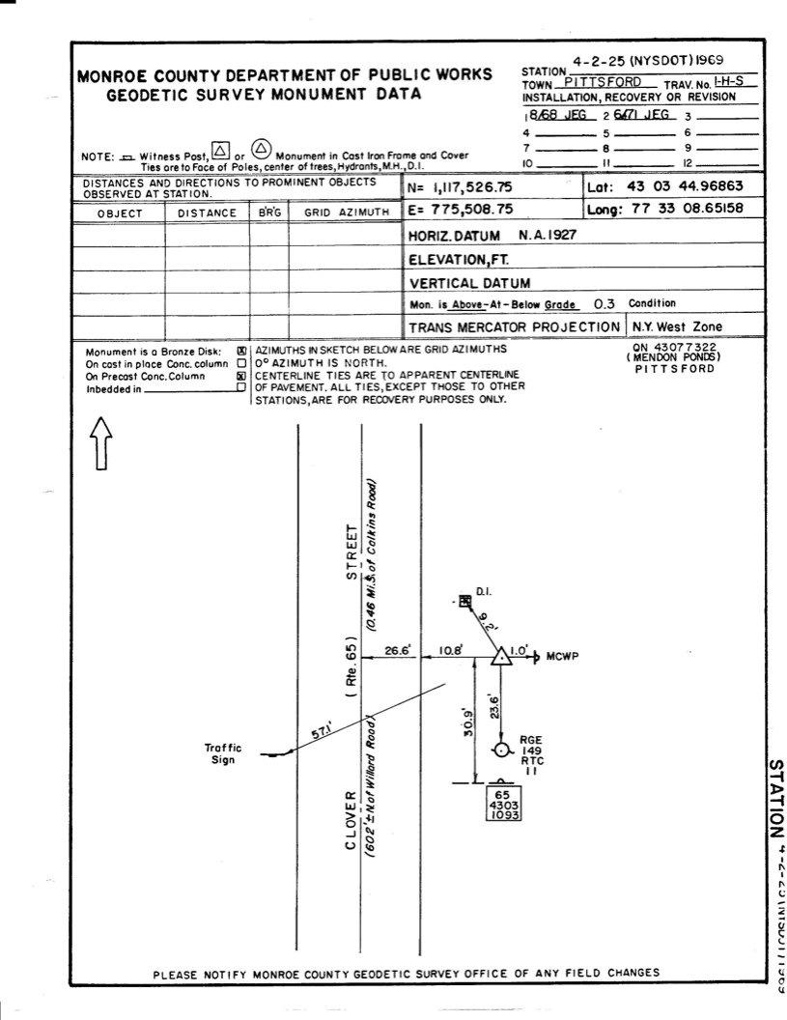
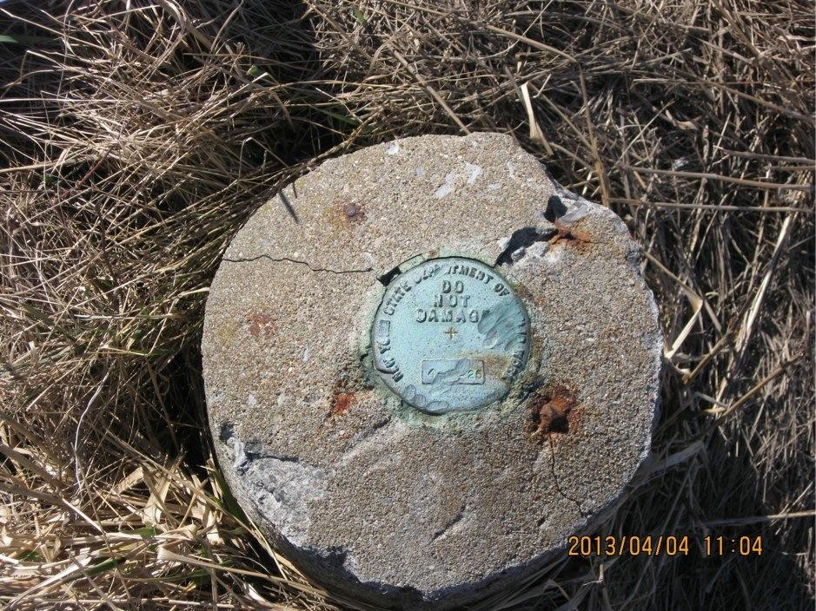
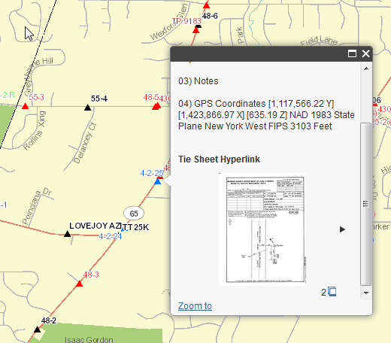
What is a control point?
http://mappingmonroe.monroecounty.gov/surveymonuments/

Slide 48
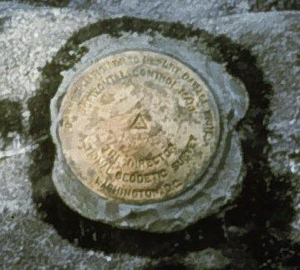
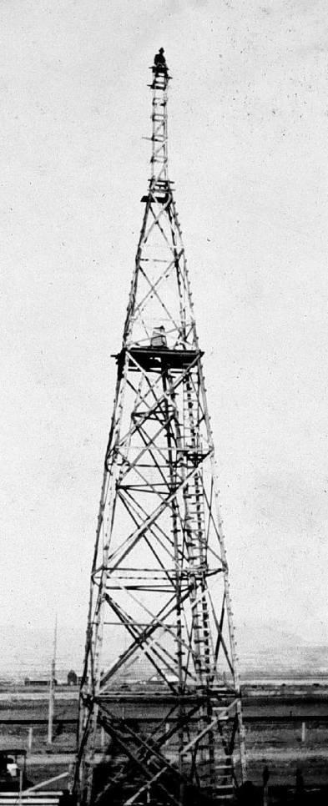
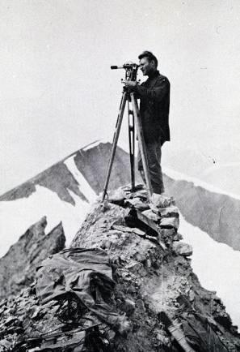
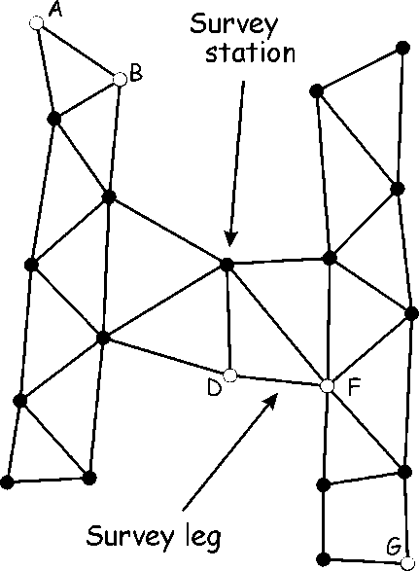
What is a datum?
Given the Equator and an arbitrary 0° Longitude location, establish accurate locations on Earth’s surface.
GIS Fundamentals, Paul Bolstad, 2002
Notes:
The horizontal datum is the model used to measure positions on the earth. A specific point on the earth can have substantially different coordinates, depending on the datum used to make the measurement. There are hundreds of locally-developed horizontal datums around the world, usually referenced to some convenient local reference point. Contemporary datums, based on increasingly accurate measurements of the shape of the earth, are intended to cover larger areas.
The WGS84 datum, which is almost identical to the NAD83 datum used in North America, is a common standard datum and the default for coordinates displayed in most commercial GPS units. The NAD27 datum is commonly used on older USGS topographic maps. The user of a GPS unit should normally change the datum it uses to display coordinates to match the datum of the map on which the coordinates are being plotted. (Wikipedia)

Slide 49
Always know the datum
Horizontal datums and reference ellipsoids have names – for example:
The North American Datum of 1927 (NAD27), which is based on the Clarke 1866 reference ellipsoid.
So? Why keep track of this information?
Different datums can vary by as much as 100 meters; a problem when comparing or overlaying data.

Slide 50
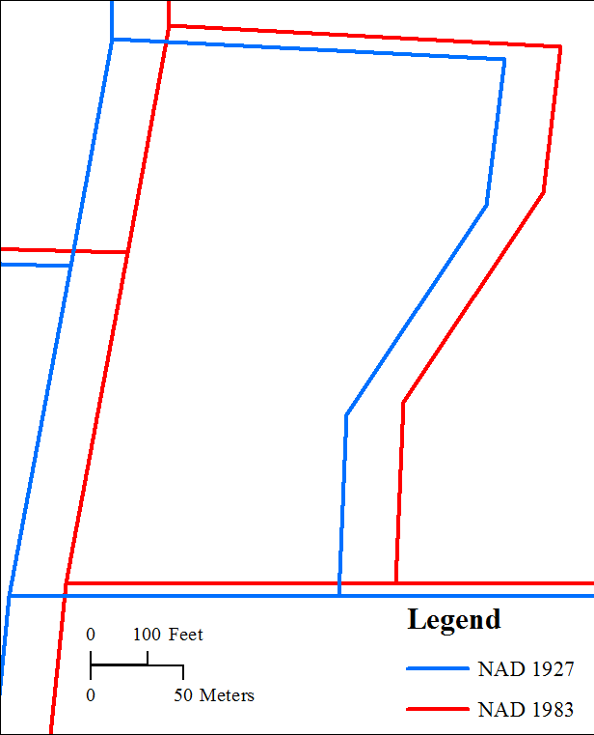
© 2013 Brian Tomaszewski

Slide 51
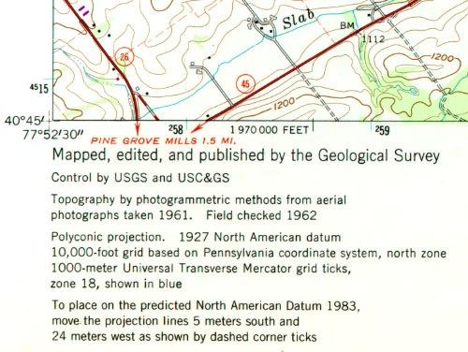
What is a datum?

Slide 52
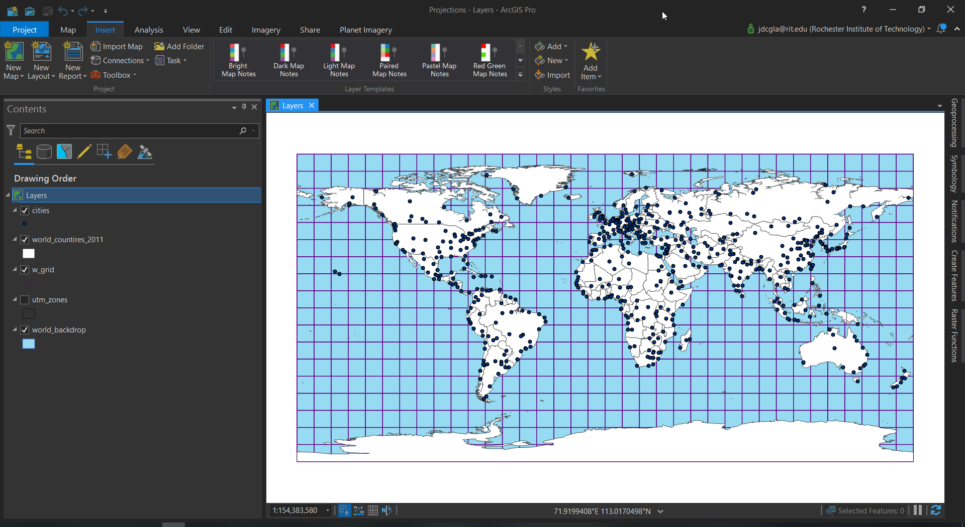
Hands On With Projections

Slide 53
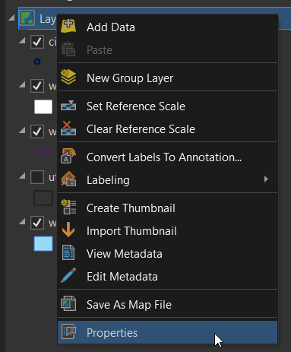
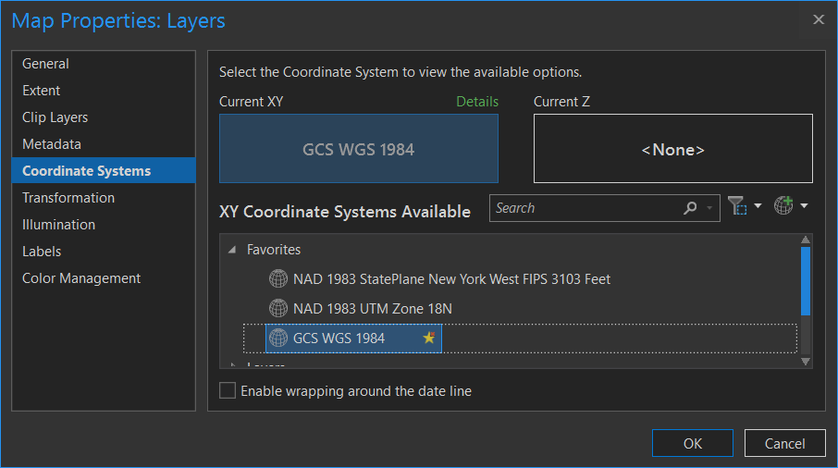
Hands On With Projections
We are going to explore the different projections using ArcGIS
Once you open the map document right click on the Data Frame (Layers) and go to dataframe properties
Then click on the Coordinate System Tab
Here you can see the different coordinate systems and see how they all draw

Slide 54
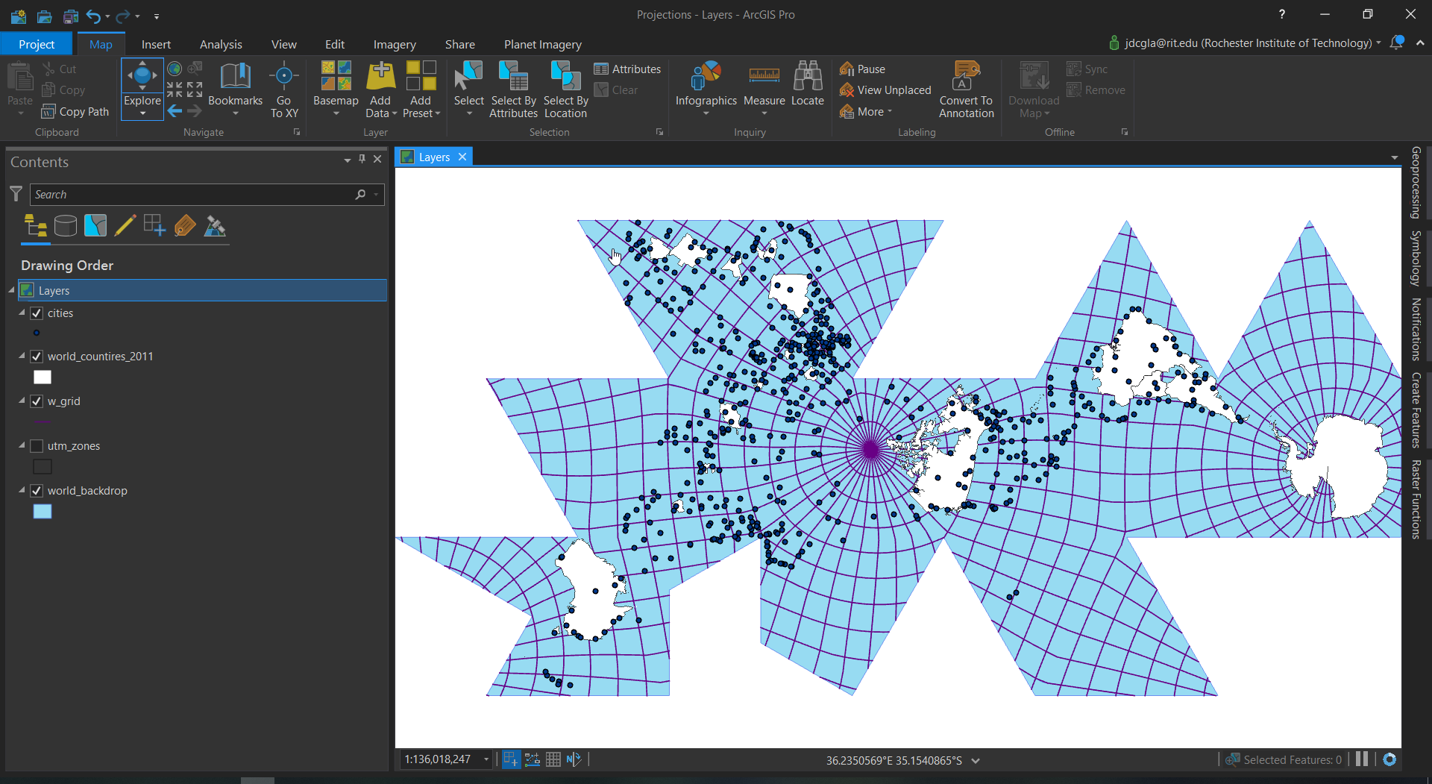
Hands On With Projections

Slide 55
Hands on with ArcGIS Pro Projections
Download the Projections.ppkx
Wait for Everyone to have the project Open

Slide 56
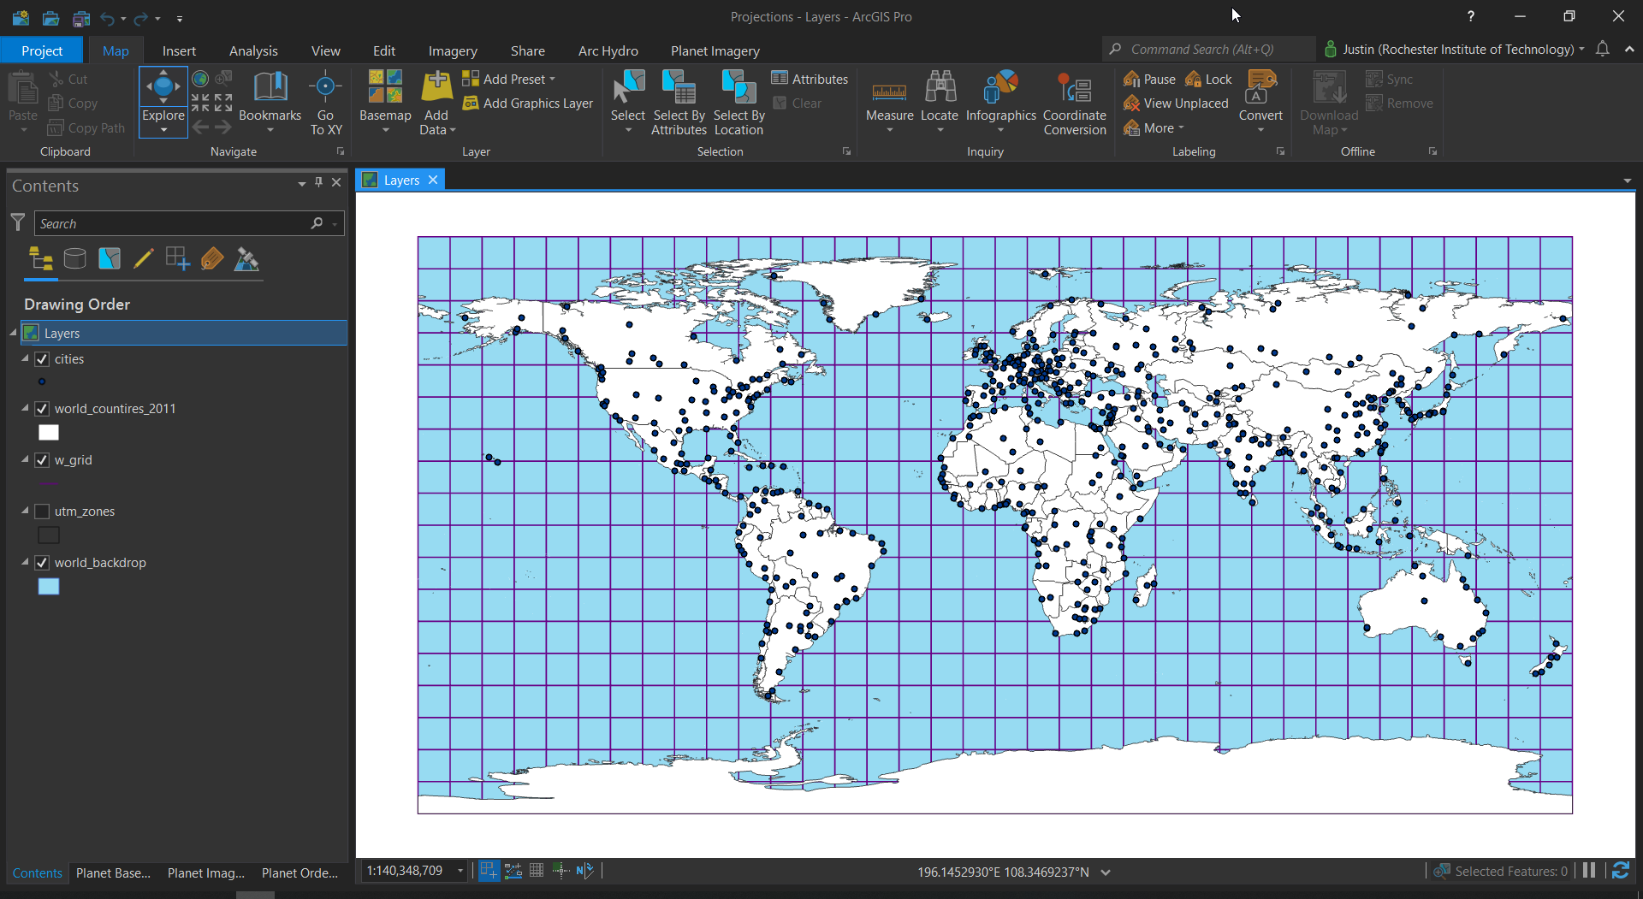
Changing the Projection

Slide 57


Changing the Projection

